Slide 1
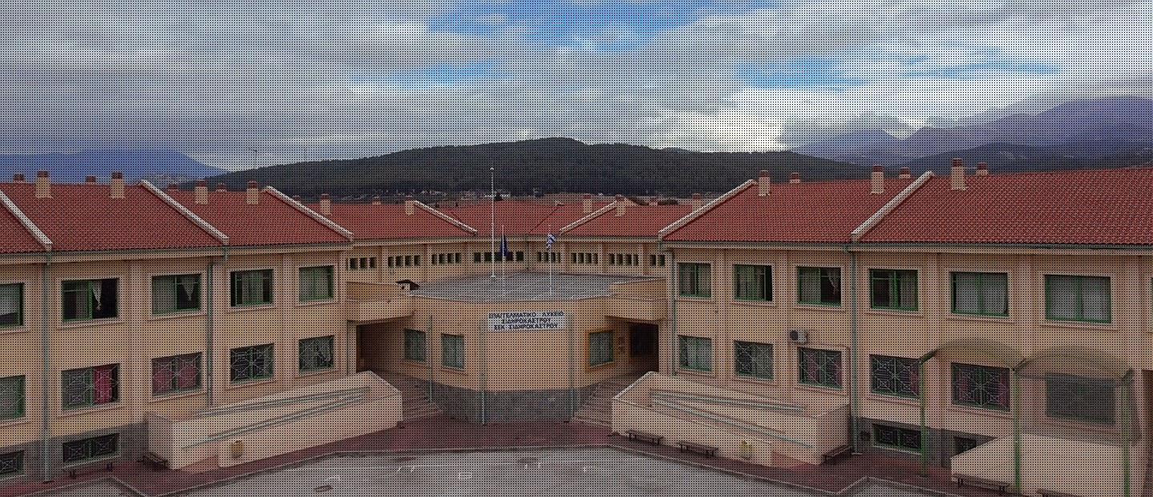

EPAL SIDIROKASTROU
YOUR GATEWAY TO EXPERIENTIAL LEARNING & BROADENING HORIZONS
2026

Slide 2
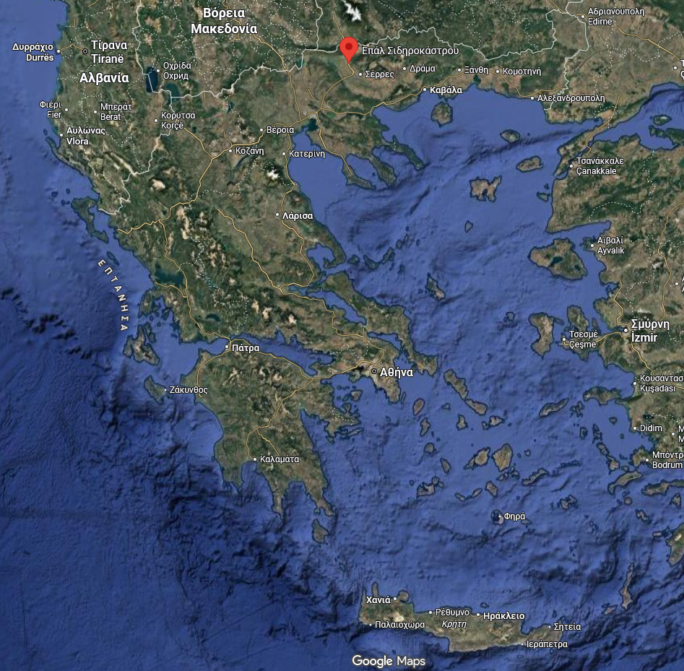
Location
Sidirokastro Serron, Central Macedonia, Greece
20 min to Serres City
20 min to the Bulgaria Borders
1h 20min to Thessaloniki
https://maps.app.goo.gl/KFw5ehxd71TCwz5z7

Slide 3
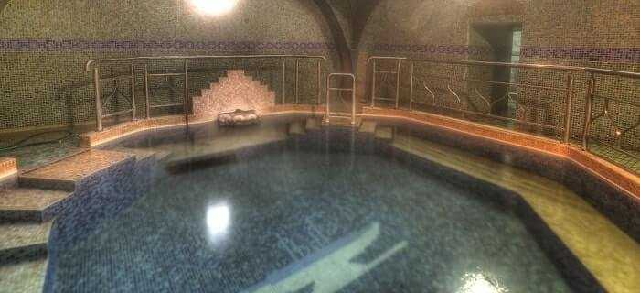
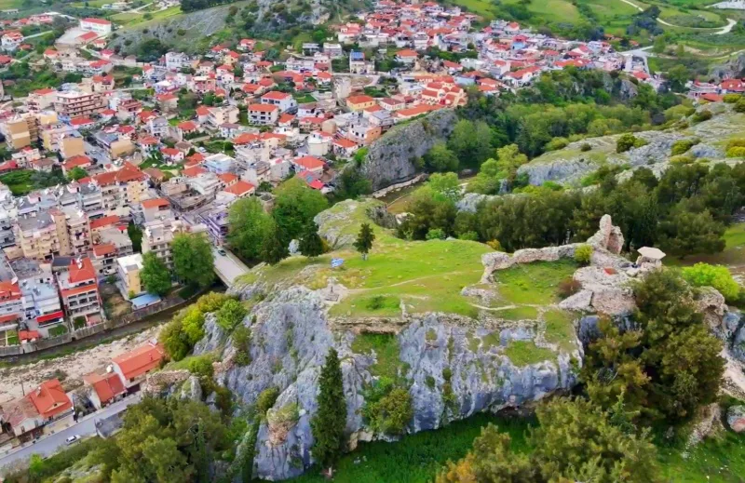
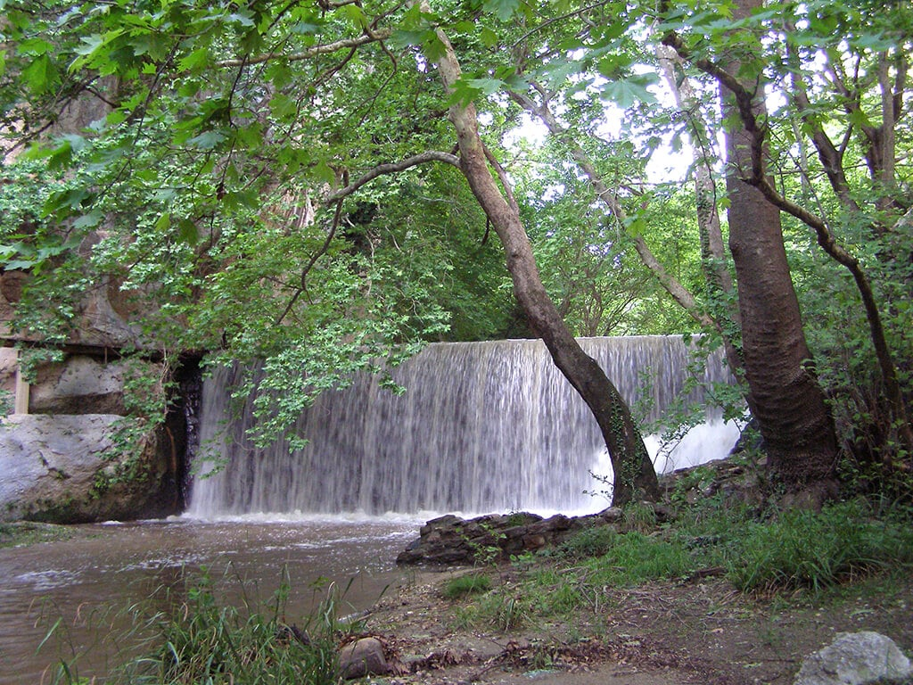
Sidirokastro

Slide 4
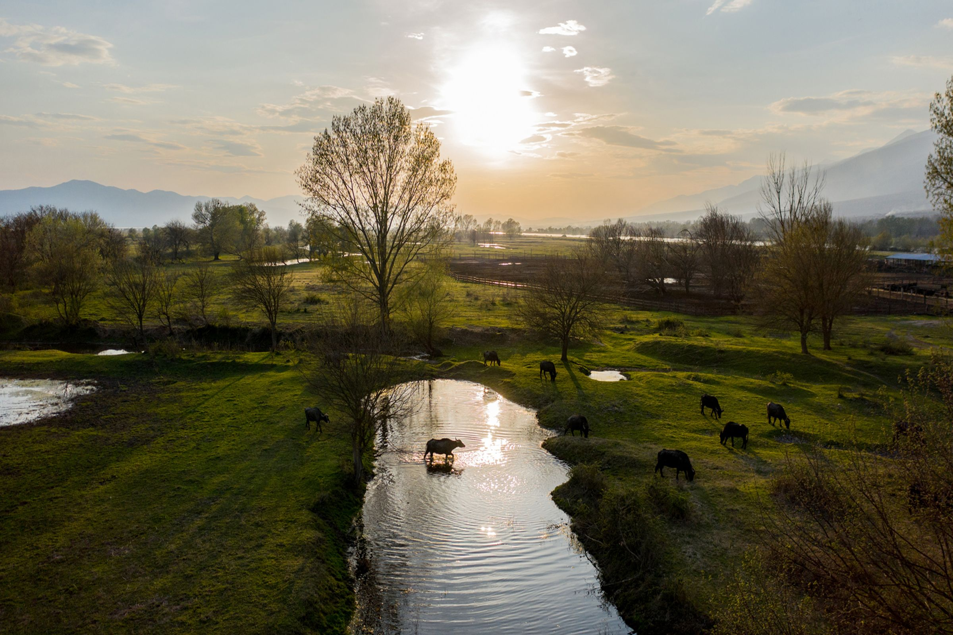
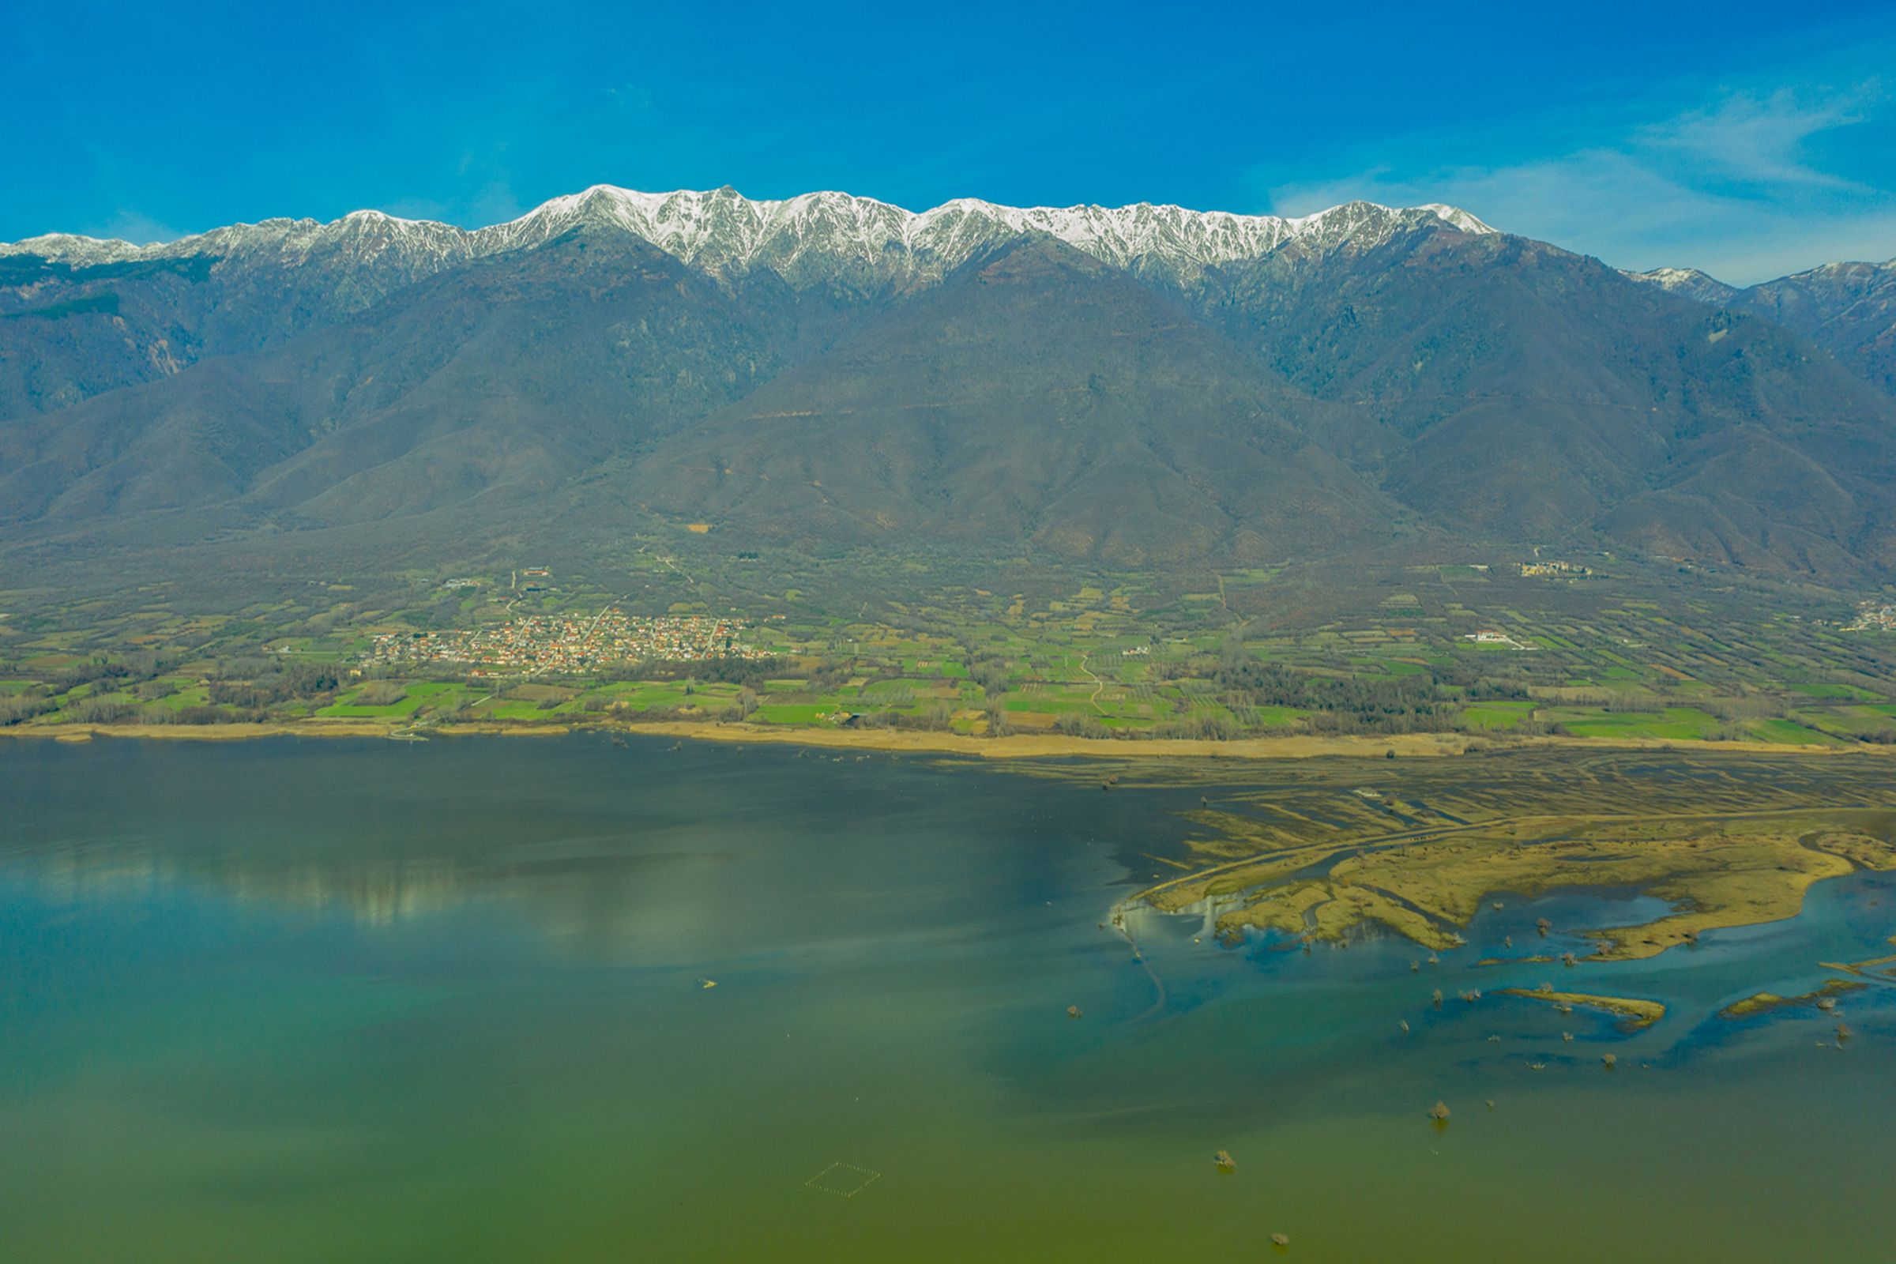
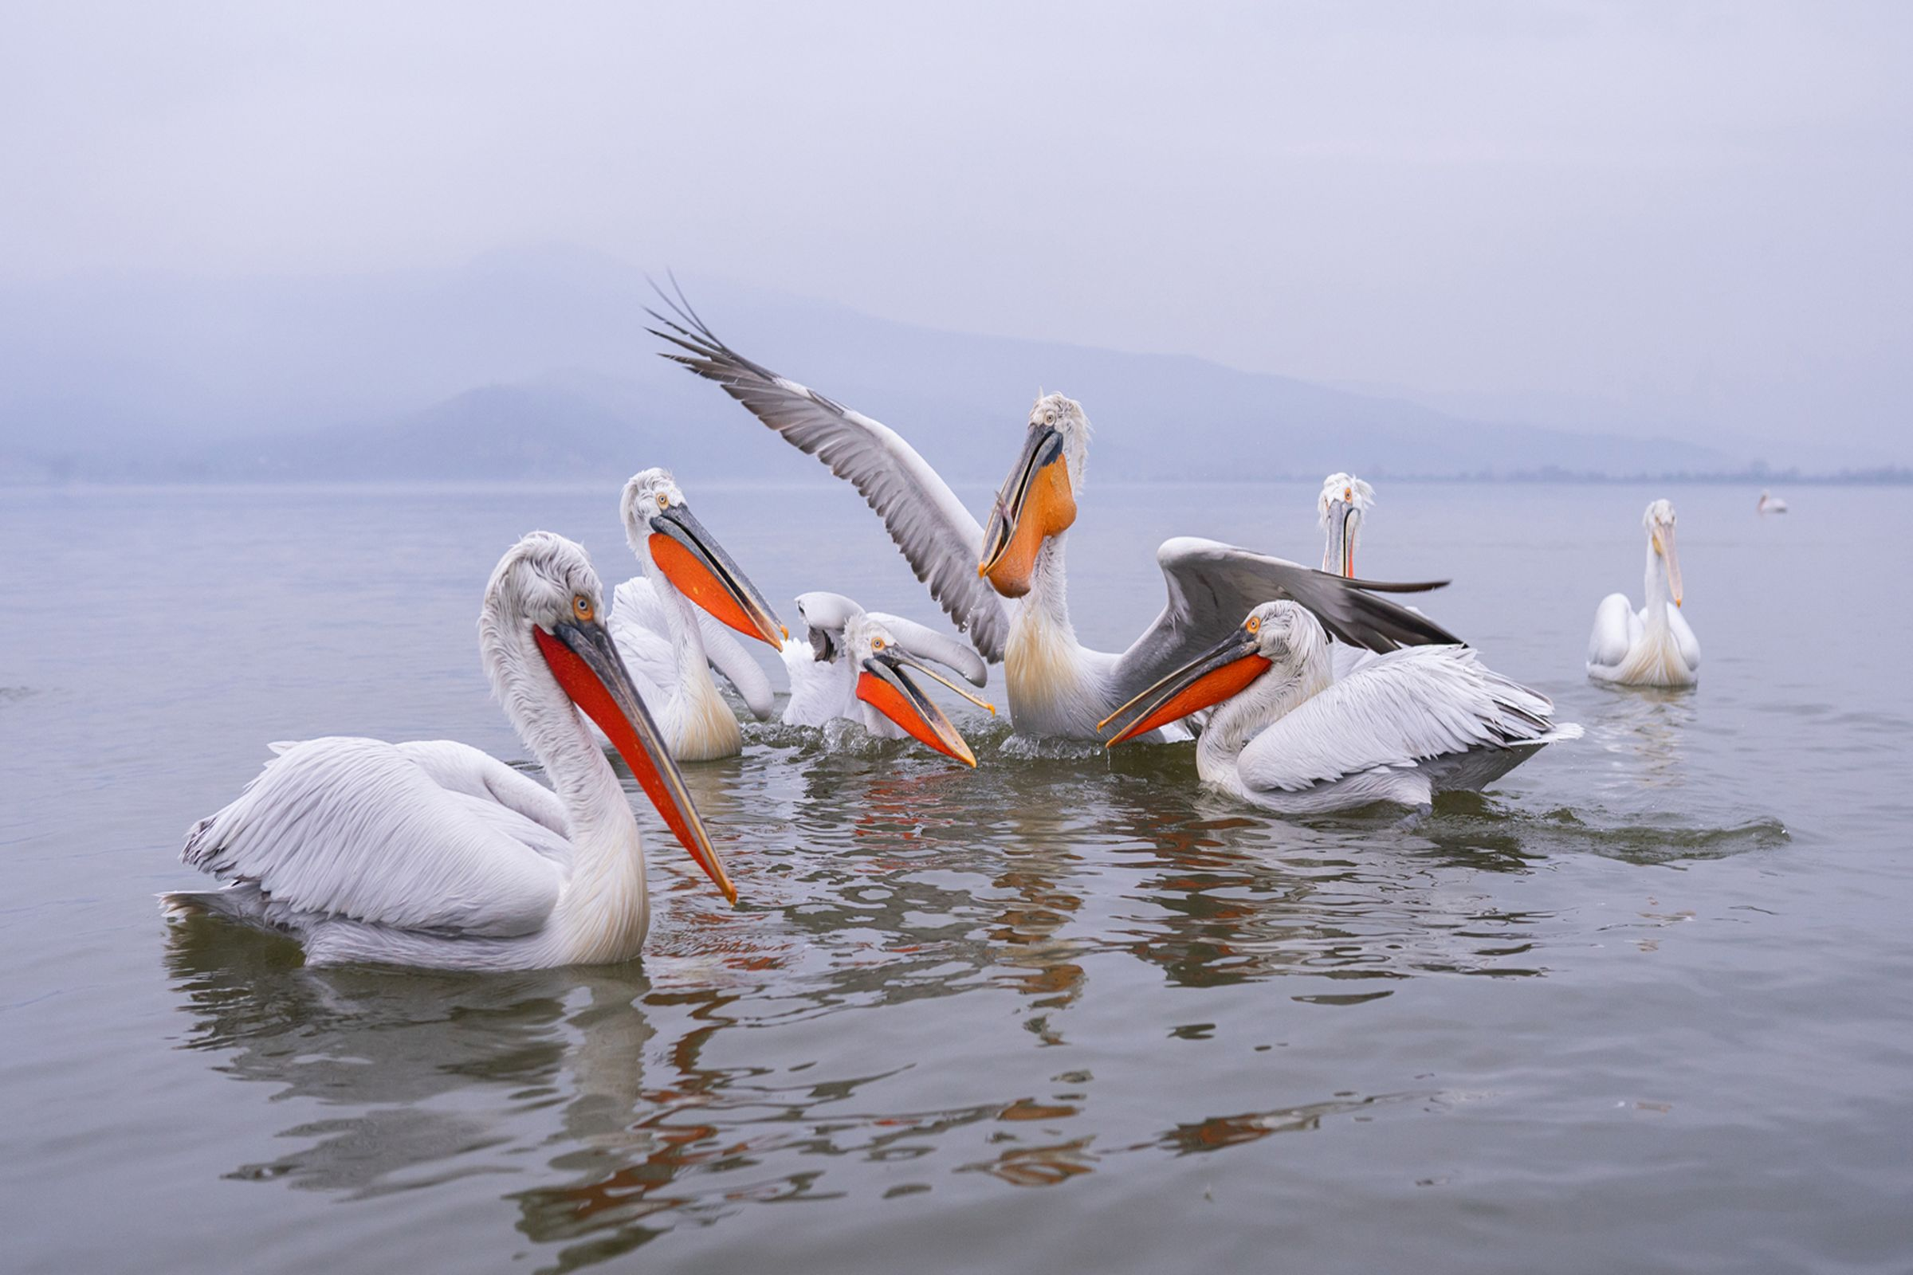
Kerkini Lake

Slide 5
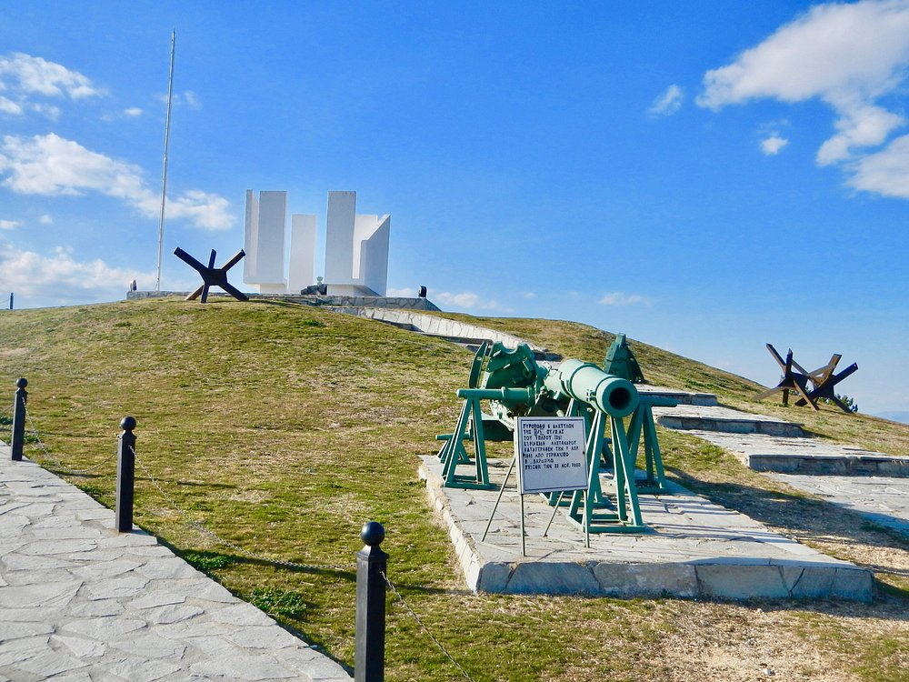
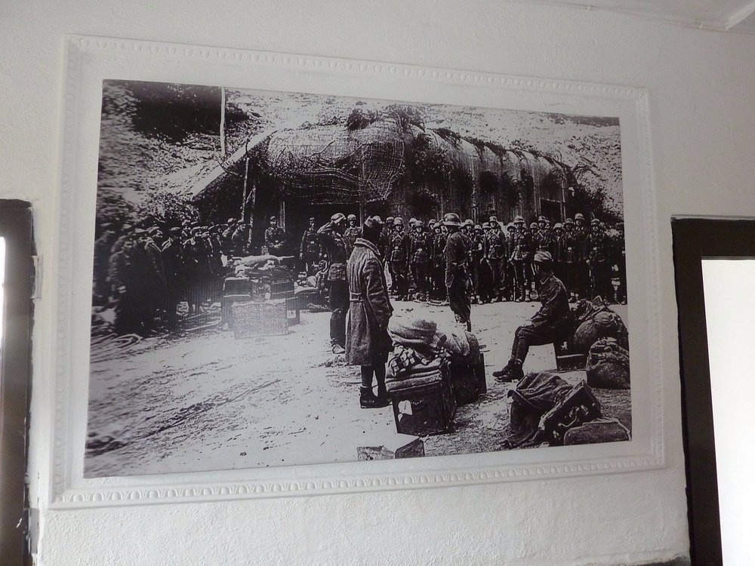
Roupel Bunker

Slide 6
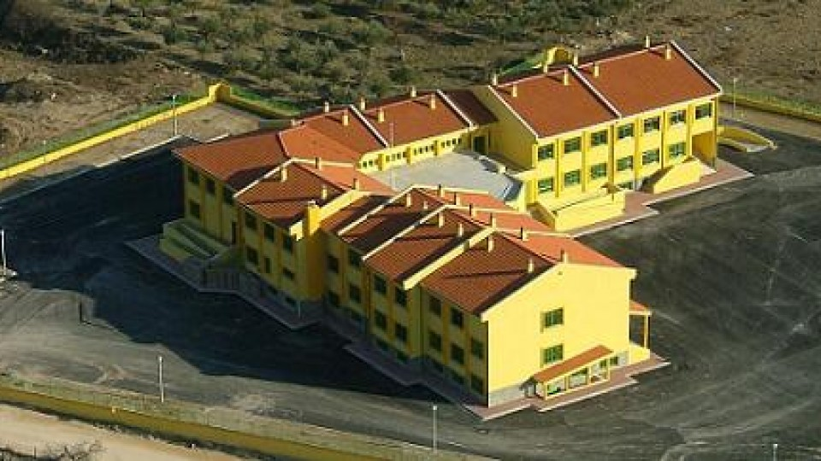
Our School
Established in 1998
About 200 Students
5 Fields of Study
Areas of School
Soccer, Basketball & Tennis Fields
Fitness Area
Amphitheater
Classes & Laboratories
Canteen
Playrooms
Parking

Slide 7

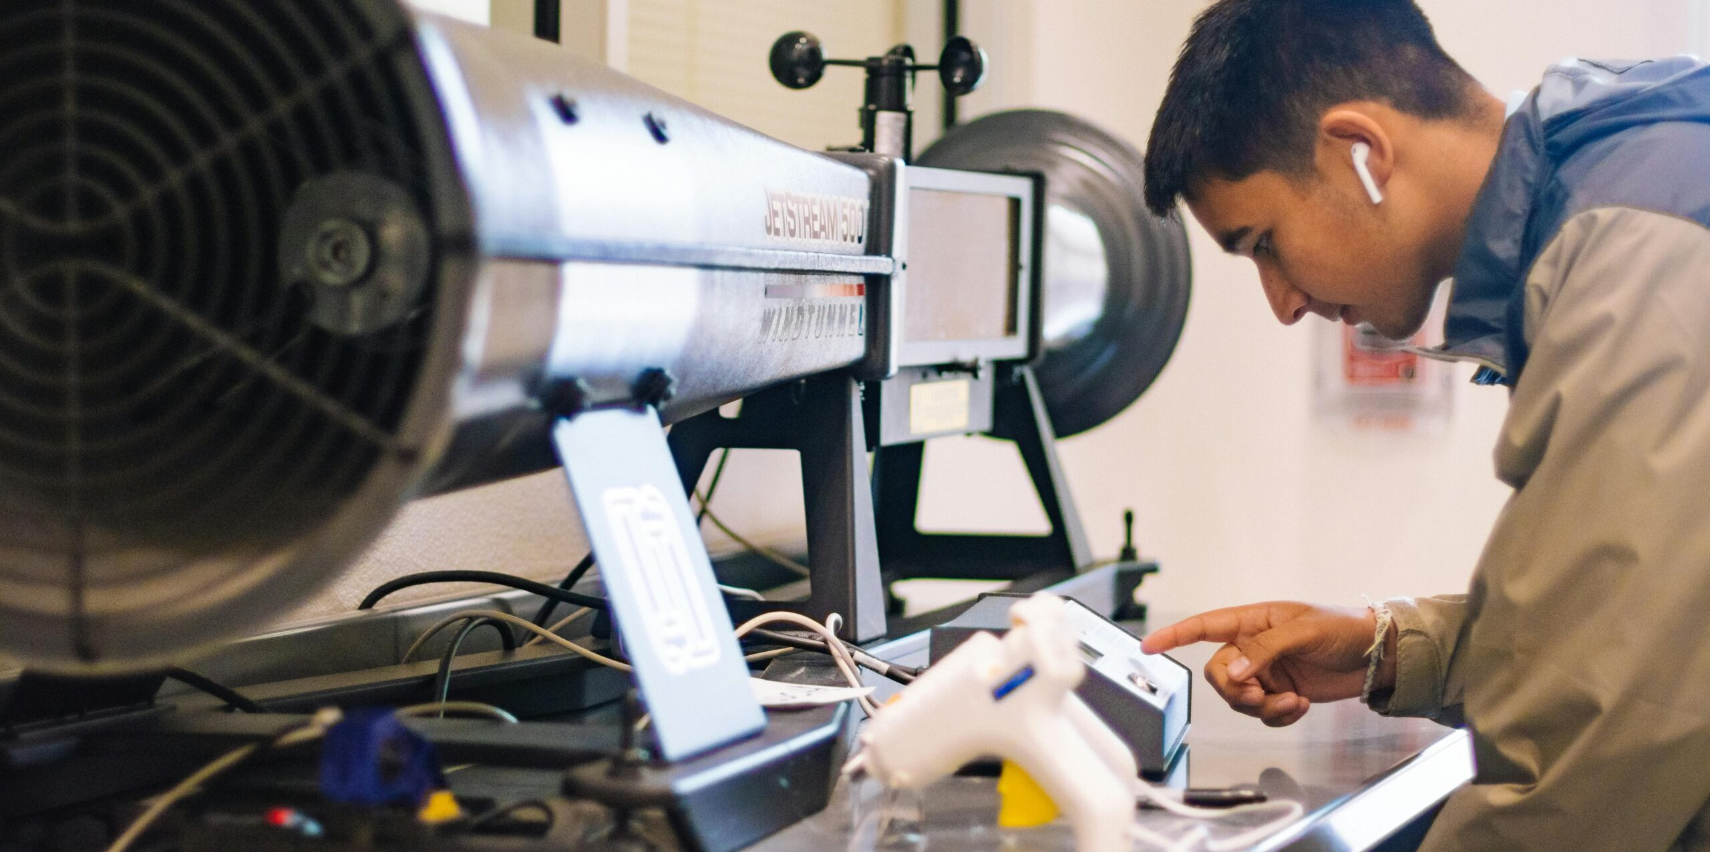
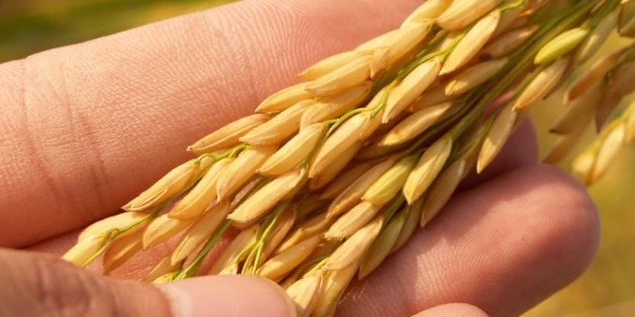
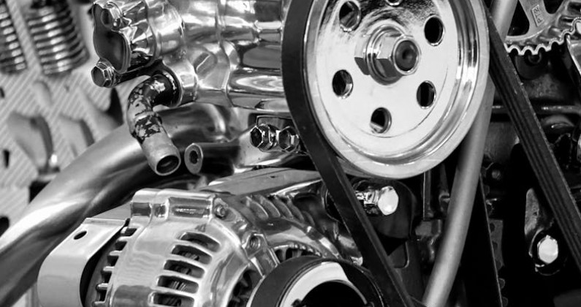
Sectors
Sector of Mechanical Engineering
Sector of Electrical Engineering
Sector of Agriculture, Food and Environment
Sector of Informatics / Computer Science
Sector of Administration and Economy

Slide 8
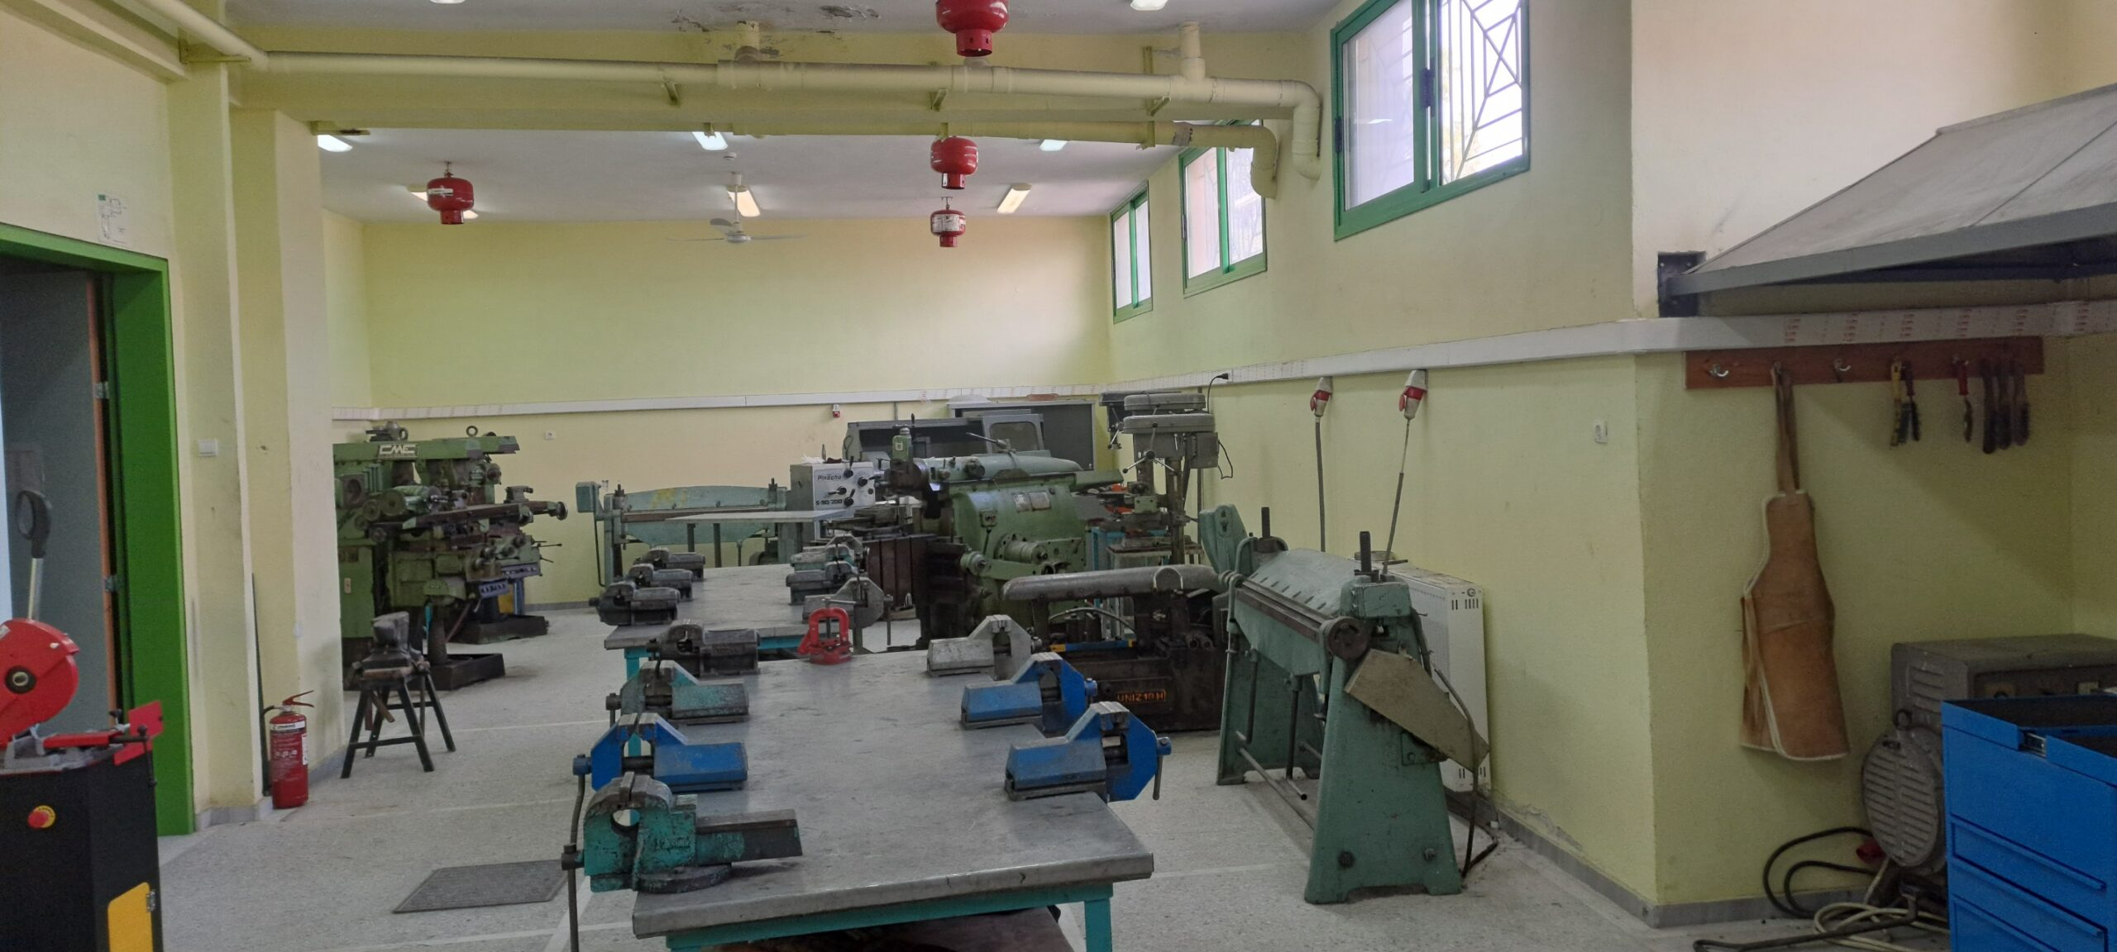
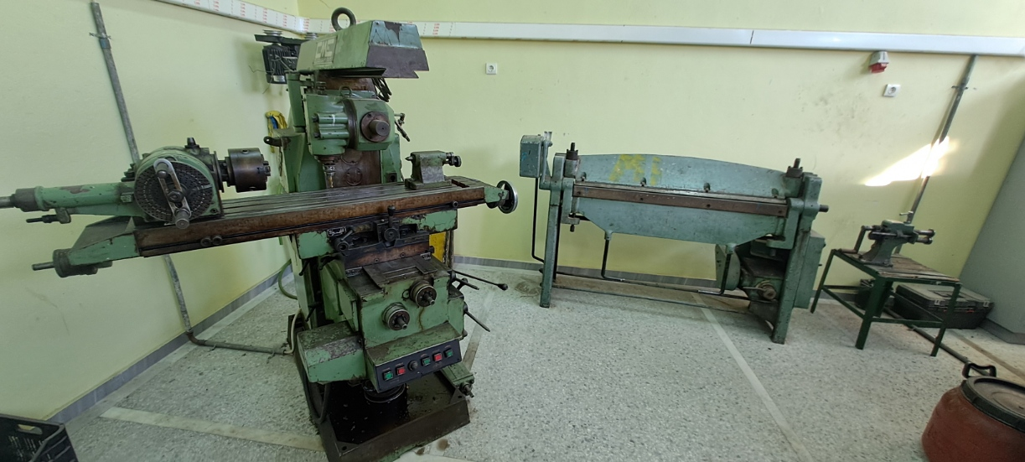
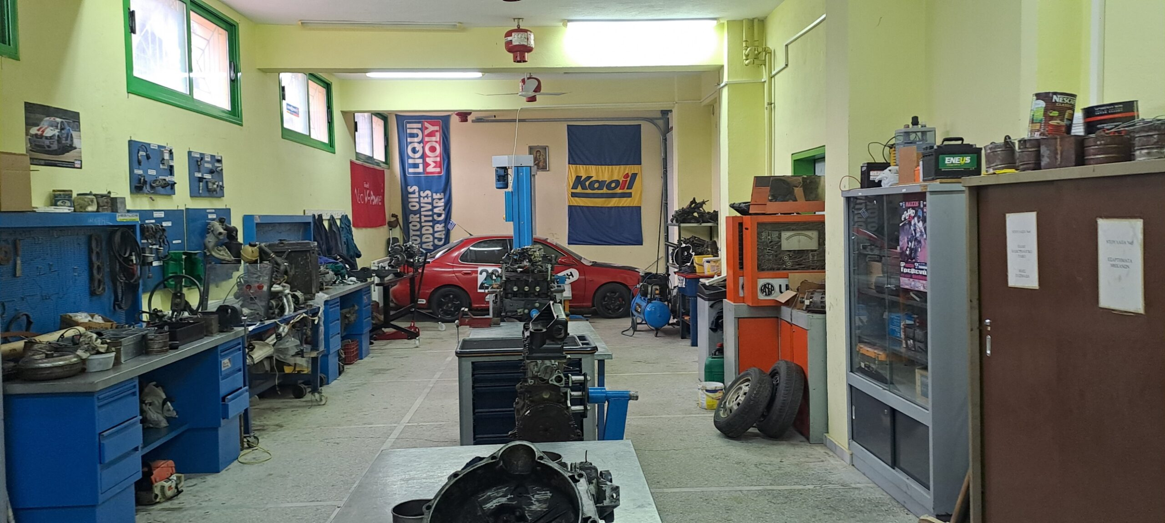
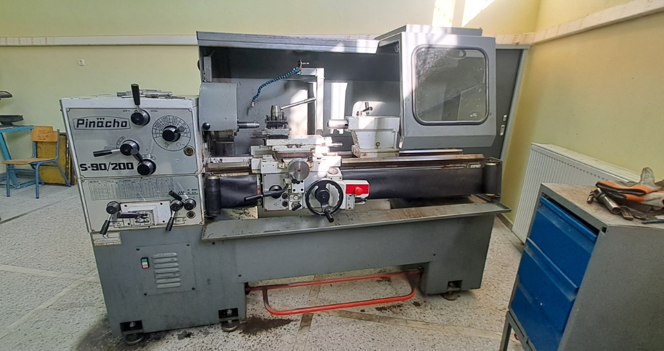
Sector of Mechanical Engineering
Vehicle Technician
Mechanical Manufacturing and Installations Technician
Refrigeration and Air Conditioning Technician

Slide 9
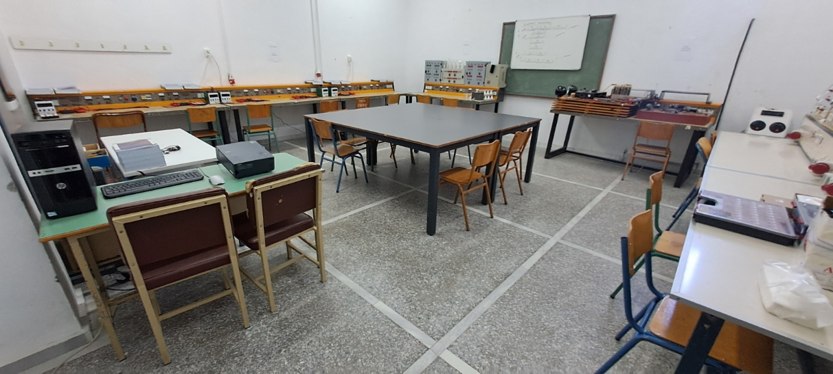
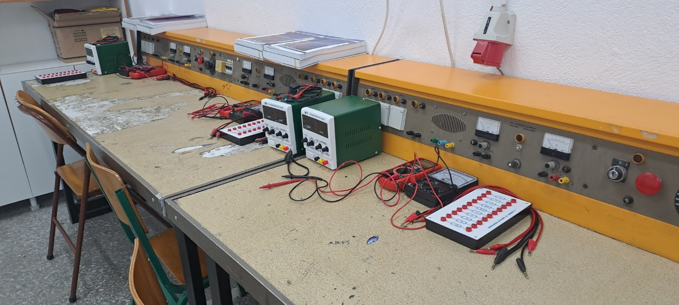
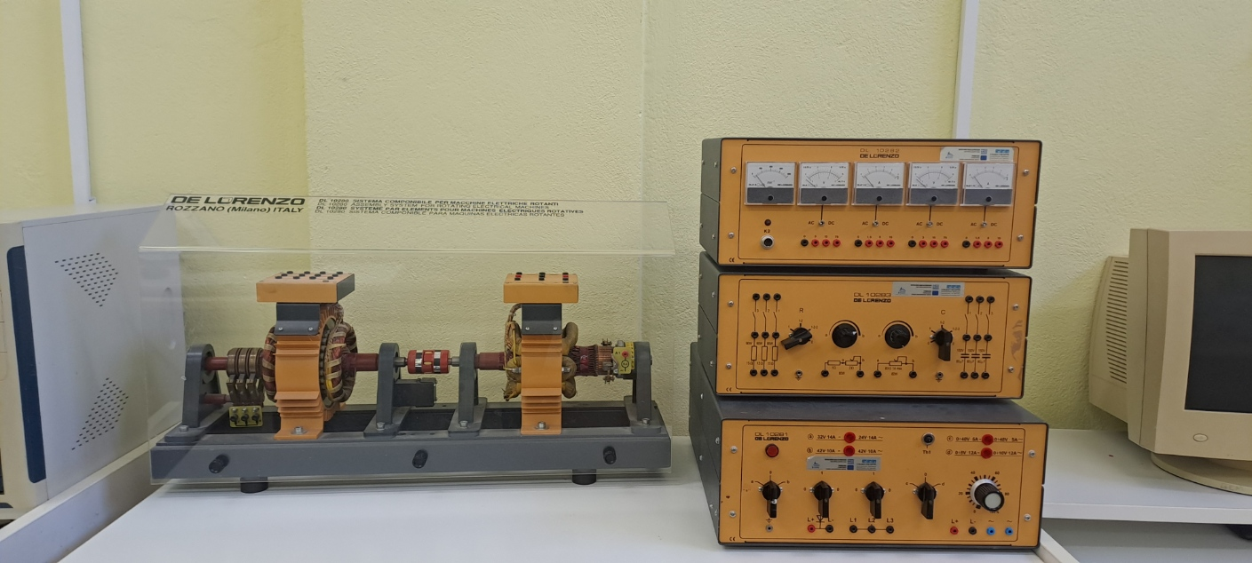
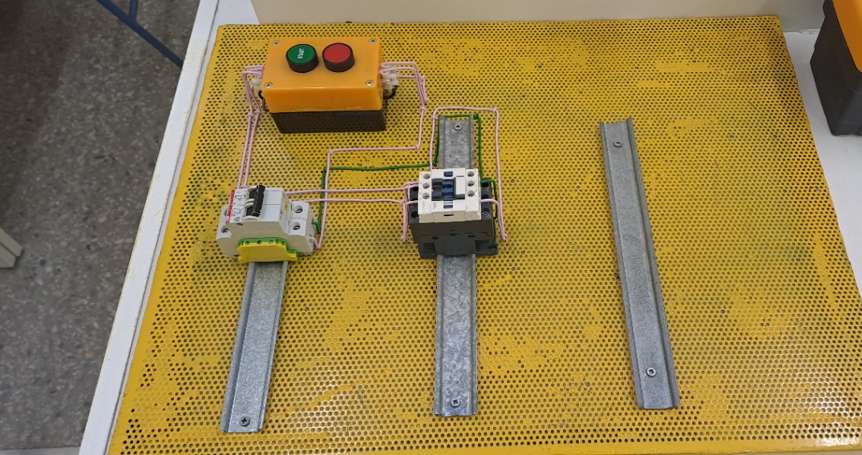
Sector of Electrical Engineering
Technician of Electrical Systems, Installations and Networks

Slide 10
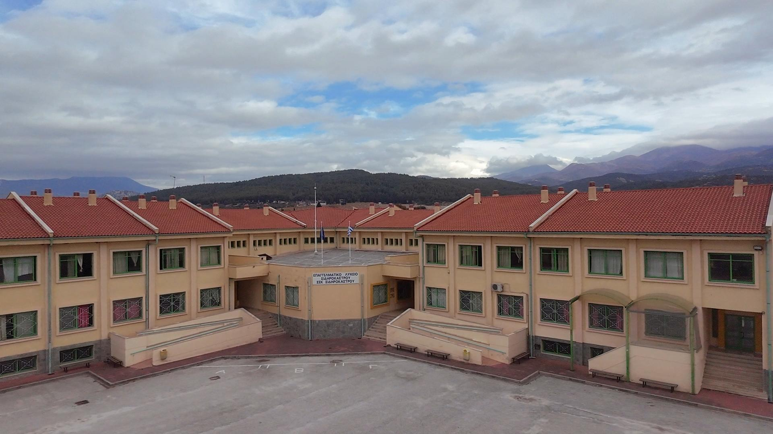
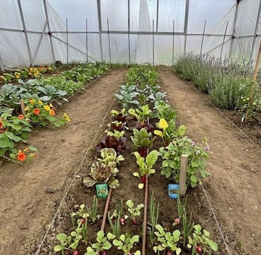
Sector of Agriculture, Food and Environment
Agricultural Technician

Slide 11
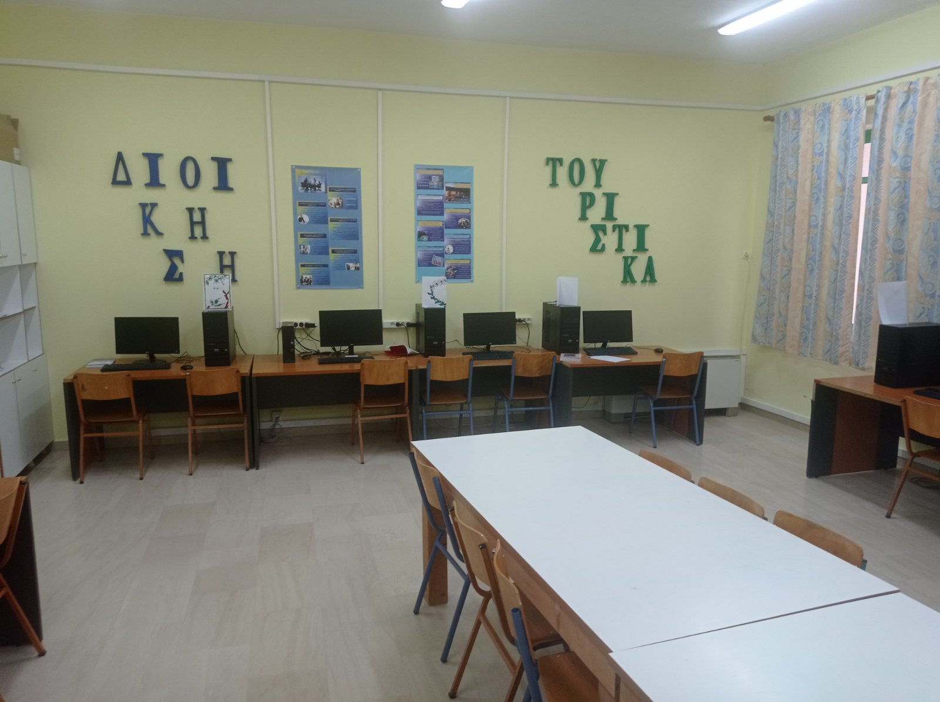
Sector of Informatics / Computer Science
IT Applications Technician

Slide 12
Sector of Administration and Economy
Administrative and Financial Services Clerk
Tourism & Hospitality Services Assistant

Slide 13
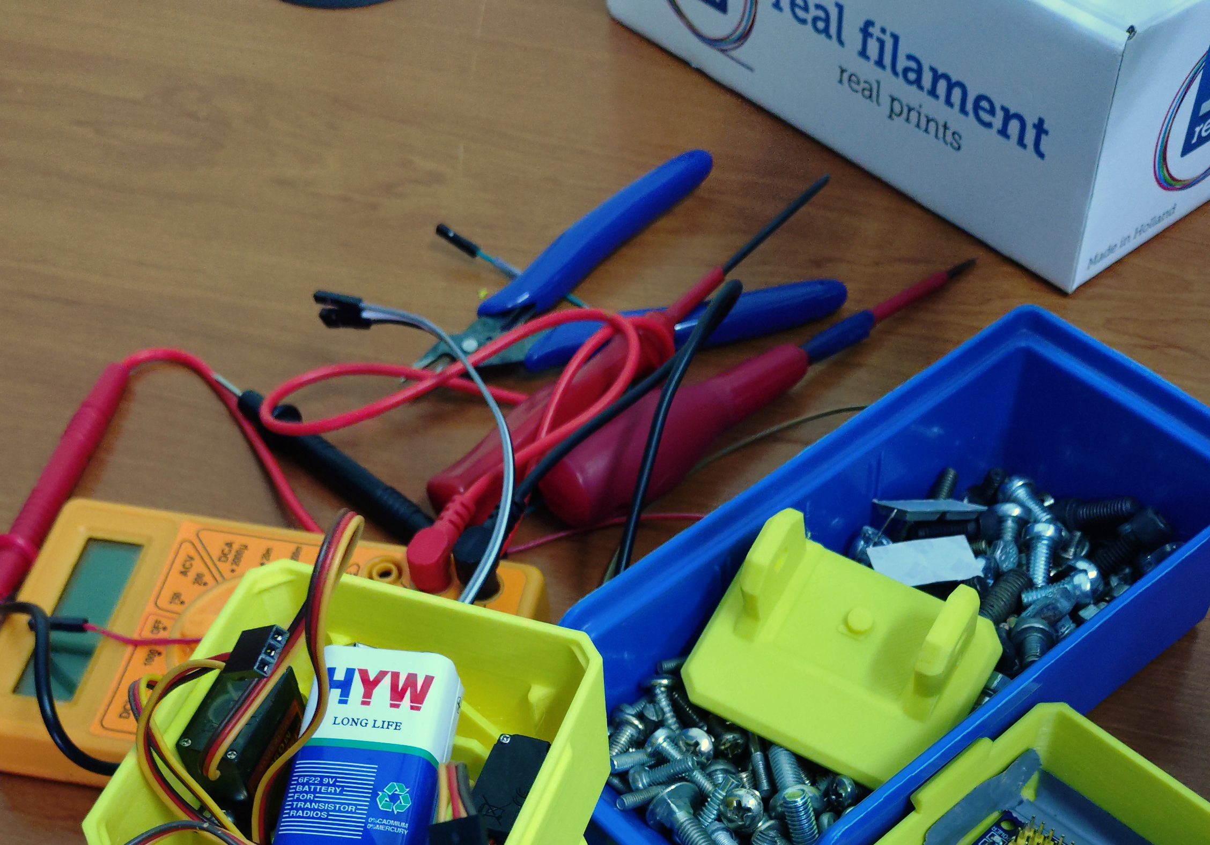
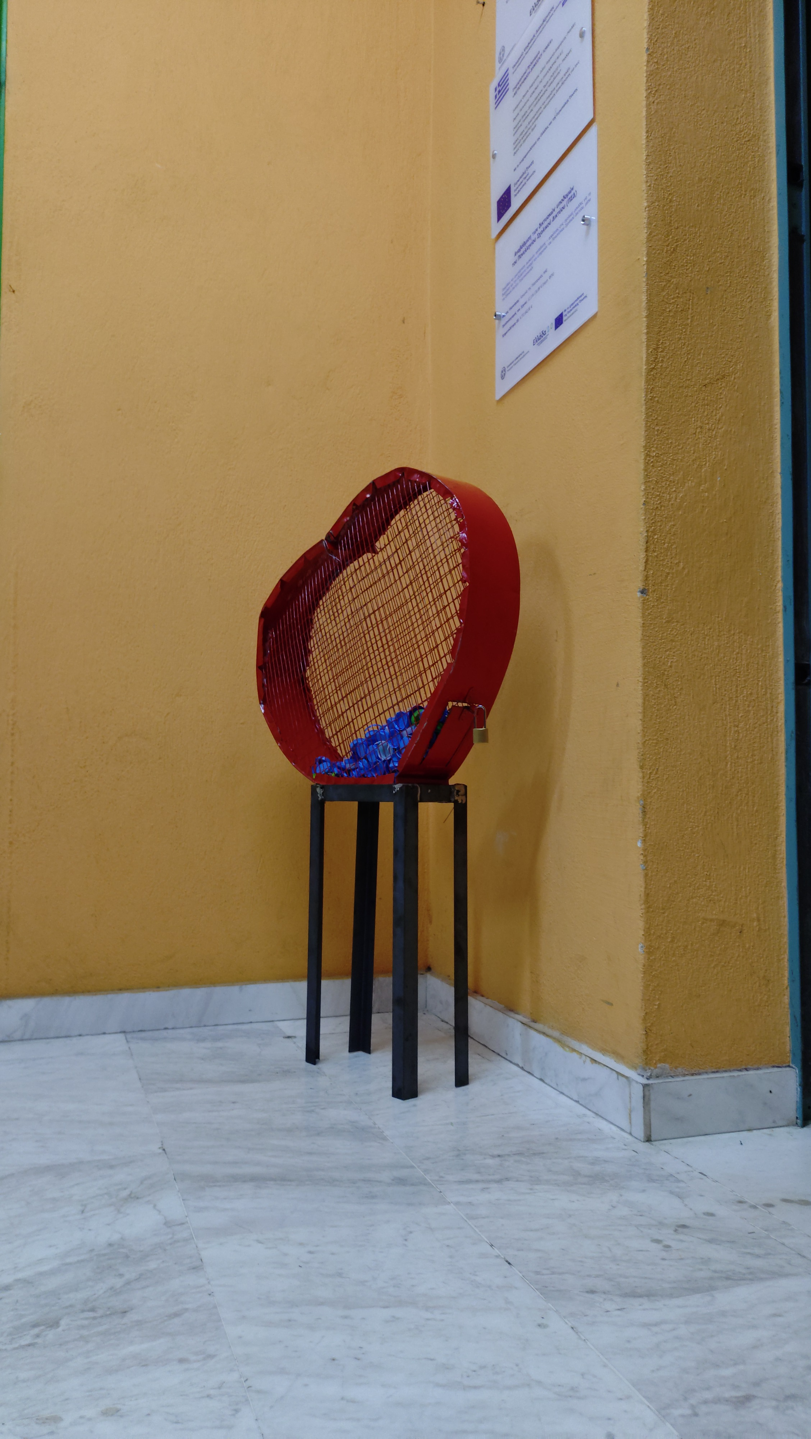
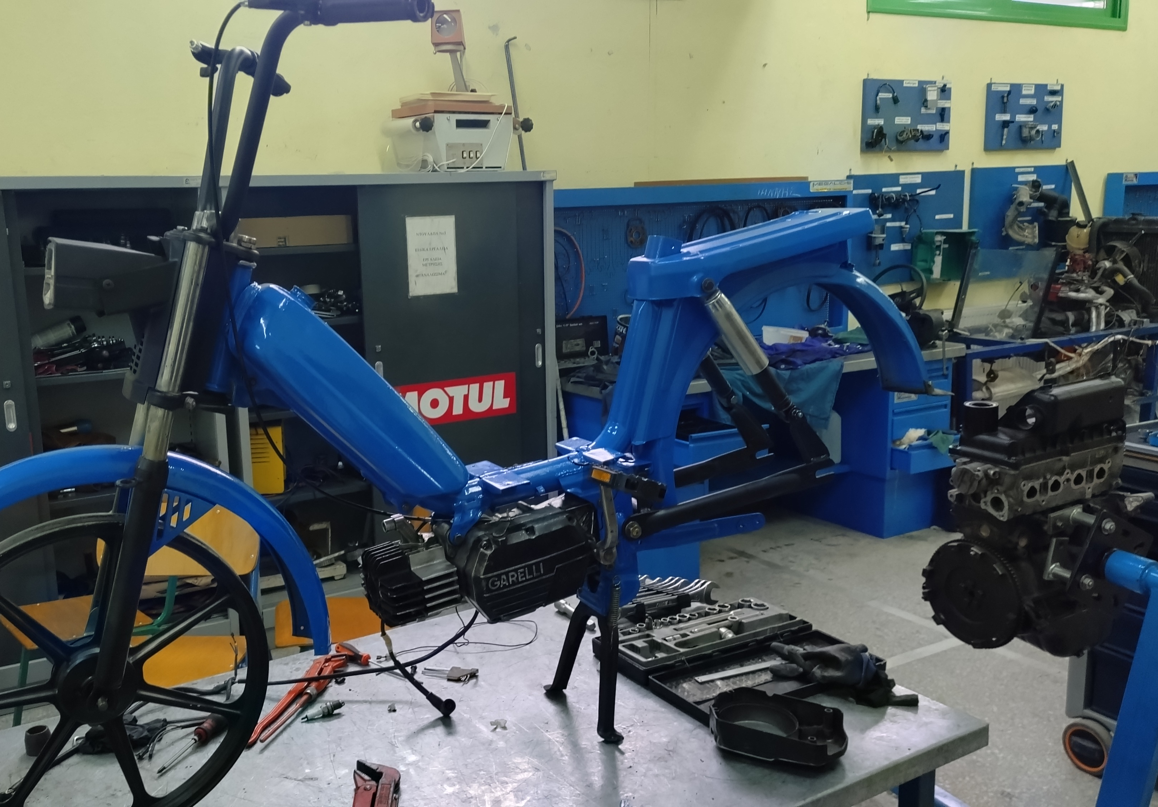
School Activities in 2026
Blood Donations
Recycling
Plastic Bottle Caps
Clothes
Batteries
Motorcycle Restoration
Robotic & 3D Printing Club
Erasmus in Cyprus (Students)
Erasmus in Finland (Teachers)
Daily Visits in Museums/Cities
Daily Visits in Companies related to our subjects
Seminars about Careers

Slide 14

Goals
Internationalization: Developing strong Erasmus+ networks.
Growth: Attracting more students to our vibrant community.
Innovation: Adding modern specializations and fields of study.
Excellence: Committing to the highest standards of education.
Networking: Building bridges with private enterprises and the market.

Slide 15
Thank you!

